Slide 1

🌍 AIR QUALITY INDEX PREDICTION
Machine Learning-Powered Environmental Analytics Using Random Forest

Slide 2

Introduction & Objectives
Air pollution represents one of the most pressing environmental challenges globally, affecting billions of people and ecosystems. The Air Quality Index (AQI) quantifies pollution severity, enabling informed public health decisions and environmental policy.
Project Goals
Predict AQI Values
Classify Conditions
Build accurate regression model for real-time air quality forecasting
Categorize air as Good, Moderate, Unhealthy, or Hazardous
Enable Insights
Deliver interactive dashboards and exportable analytical reports

Slide 3

Data Pipeline & Preprocessing
A robust data engineering foundation ensures model reliability. Our workflow transformed raw Kaggle Air Quality Data into production-ready features through systematic preprocessing.
01
Data Collection
Kaggle dataset with date, country, pollution status, and AQI values
02
Feature Engineering
Removed temporal columns; encoded categorical variables (Country, Status) using LabelEncoder for model compatibility
03
Normalization
Applied StandardScaler to numerical features, ensuring consistent input ranges across all predictors
04
Train-Test Split
80% training, 20% testing for unbiased model evaluation and generalization assessment

Slide 4

Model Architecture & Performance
Why Random Forest?
Non-linear Pattern Recognition: Captures complex environmental relationships
Ensemble Strength: Multiple decision trees reduce overfitting risk
Robust Handling: Manages both categorical and numerical features natively
Feature Importance: Identifies critical AQI predictors
0.92
6.15
8.42
R² Score
Mean Absolute Error
RMSE
Model explains 92% of AQI variance, demonstrating excellent predictive power
Average prediction deviation—tight accuracy for environmental decision-making
Root Mean Squared Error penalizing larger deviations, confirming model stability
Model saved as aqi_model.pkl for production deployment and Streamlit integration.

Slide 5






Streamlit Dashboard: Core Features
CSV Upload
Manual Input
Batch process datasets for large-scale AQI predictions
Real-time predictions via intuitive form controls
Visualizations
Voice Alerts
Heatmaps, pair plots, and feature importance charts
pyttsx3-powered audio feedback for accessibility
PDF Reports
Modern UI
Export comprehensive analysis and predictions
Animated gradients and floating air quality icons

Slide 6

User Experience Design
The application prioritizes accessibility, clarity, and real-time feedback for data scientists and environmental professionals.
Gradient Aesthetic
Animated background reduces cognitive load while maintaining visual interest and professional appearance
Centered Metrics
Prominent display of predictions with color-coded AQI categories for instant comprehension
Sidebar Controls
Non-intrusive refresh mechanisms and parameter adjustment without disrupting analysis flow
Voice Integration
Auditory feedback enhances accessibility and provides confirmatory alerts for critical predictions

Slide 7
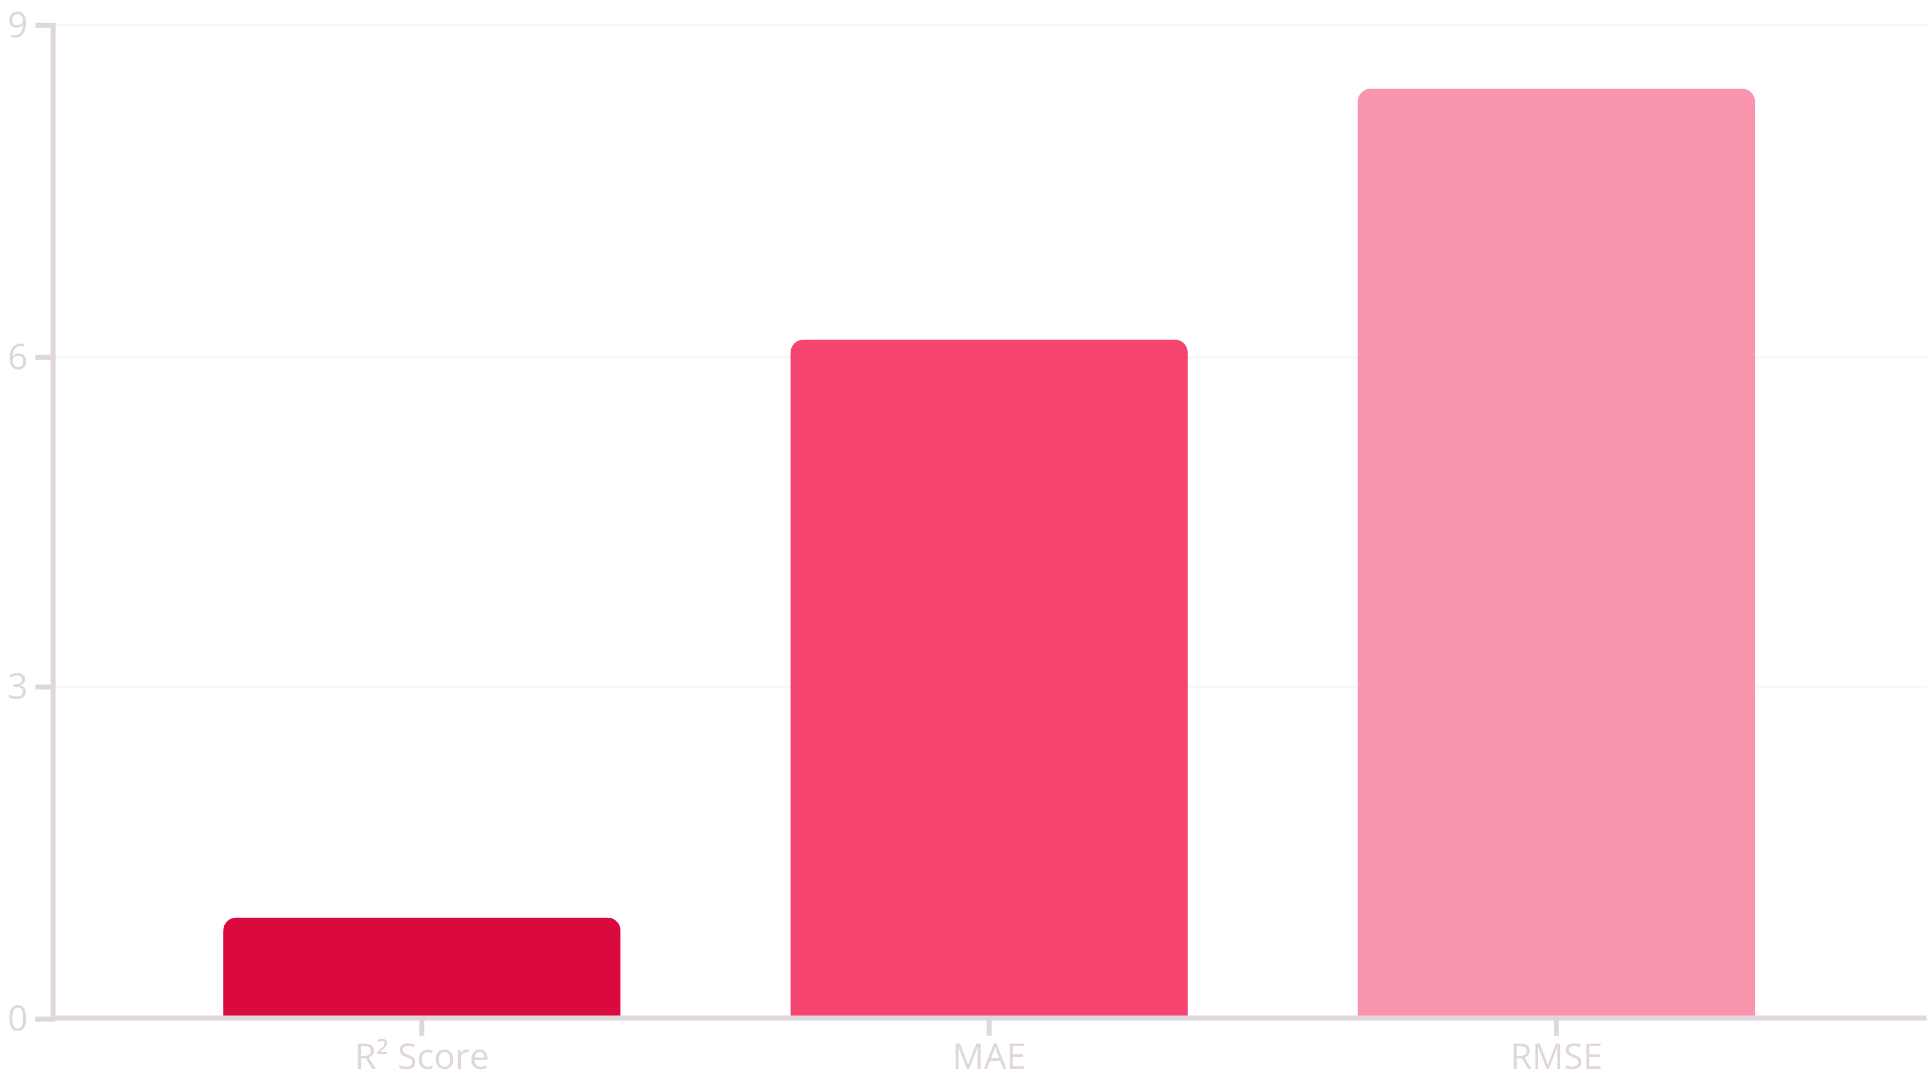
Model Performance Summary
The Random Forest model demonstrates exceptional reliability across all evaluation metrics, validating its readiness for production deployment in environmental monitoring applications.
Key Insight: With 92% variance explained and a mean absolute error of only 6.15 AQI points, the model achieves reliable precision for environmental decision-making and public health applications.

Slide 8

Conclusions & Impact
This AI-powered AQI prediction system successfully integrates machine learning with environmental science, enabling stakeholders to make data-driven decisions about air quality management and public health interventions.
1
Modular Architecture
2
Production Ready
3
Extensible Framework
Scalable design supports seamless integration of additional data sources and predictive models
Streamlit deployment enables rapid prototyping and stakeholder accessibility without infrastructure overhead
Foundation for real-time forecasting, regional analysis, and alert systems

Slide 9
Technical Stack
The project leverages industry-standard tools optimized for data science workflows, ensuring maintainability, scalability, and collaborative development.
Category
Technologies
Language
Python 3 (3.8+)
Framework
Streamlit (interactive web dashboards)
ML Engine
Scikit-learn (Random Forest Regressor)
Data Processing
Pandas, NumPy (transformations and analysis)
Visualization
Matplotlib, Seaborn (statistical graphics)
Accessibility
pyttsx3 (text-to-speech alerts)
Reporting
fpdf (portable document generation)
Persistence
Pickle (model serialization)

Slide 10



Future Roadmap
Time-Series Forecasting
Deploy LSTM neural networks for sequential AQI prediction capturing temporal dependencies
Geo-Spatial Analysis
Integrate Folium and Plotly for interactive mapping of regional air quality zones
IoT Integration
Ingest live sensor data from distributed air quality monitoring networks
Smart Alerting
Multi-channel notifications (email, SMS) with conversational AI capabilities
References: Kaggle Air Quality Dataset • Scikit-learn Documentation • Streamlit Official Guide • WHO Air Quality Guidelines

